Slide 2
ABOUT OUR COMPANY
"Brain Development" Ltd. was established in 2012 in St.Petersburg, Russia.
“Brain Development” Ltd. is:
the developer and the manufacturer of the Line of educational construction toy in robotics, neuroscience, systems of computer vision and additive technology "ROBOTRACK" for the education system from kindergarten to university.
the creator of the franchise network of International Robotics Clubs "ROBOTRACK" (opened over 130 clubs in Russia and Kazakhstan), in 47 regions and cities of Russia and Kazakhstan.
OUR PARTNERS

Slide 3
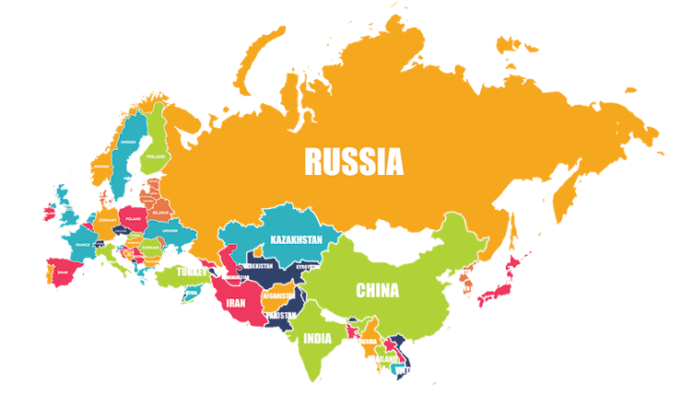
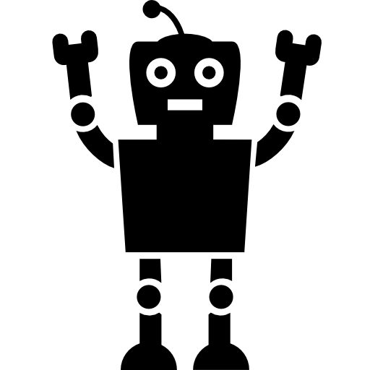
OUR ACHIEVEMENTS
More than 130 Clubs have been opened in the 47 cities and regions of Russia and Kazakhstan.
More than 40 000 children are trained in public and private educational institutions of the Russia and Kazakhstan on the basis of the developed teaching and methodical complex.

Slide 4
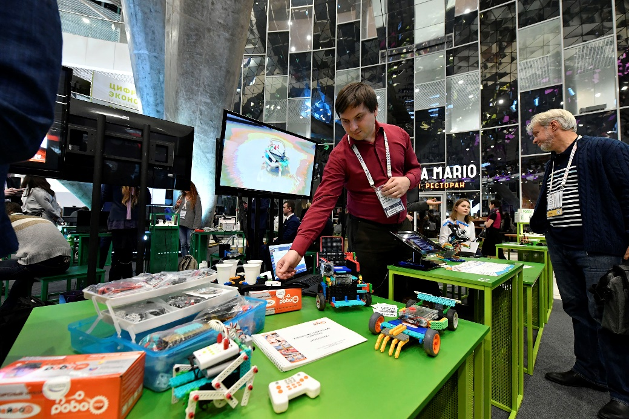
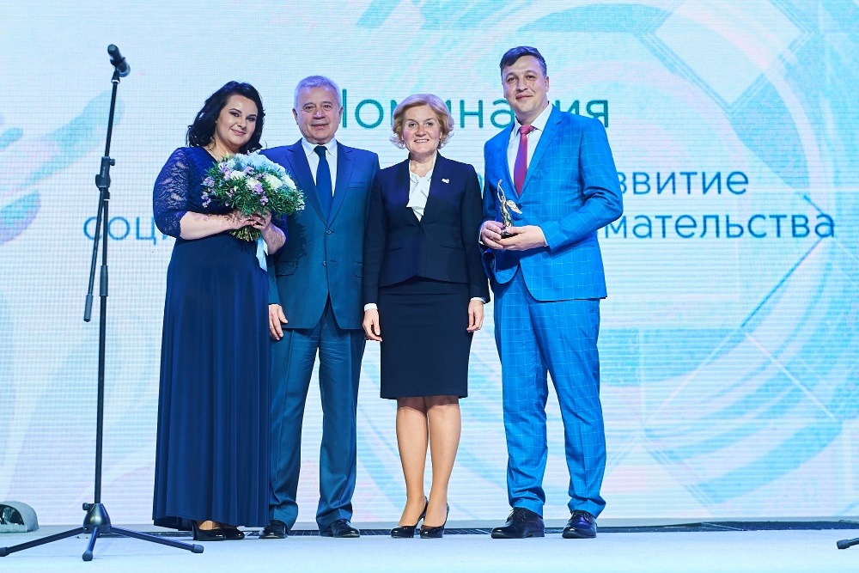
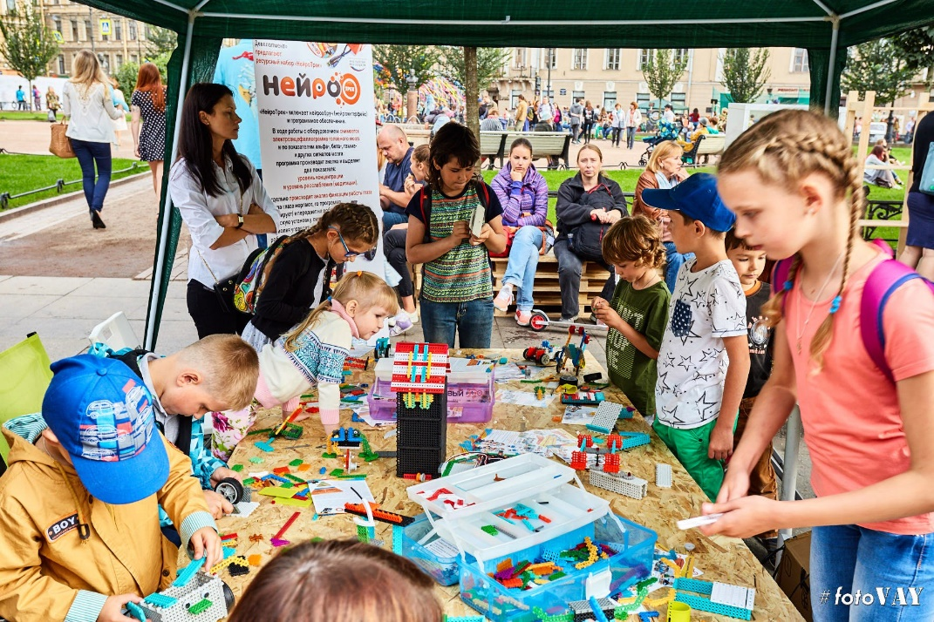
OUR ACHIEVEMENTS
The official representative of the International Youth Robot Association (IYRA) in Russia.
Company was included in the list of TOP-10 of The Best Russian Manufacturers of the goods for children by Ministry of Industry and Trade of the Russian Federation.
Prizewinner of the nomination "Personal contribution to the development of social entrepreneurship in Russia“ of VI Annual Award "Impulse of Good".

Slide 5
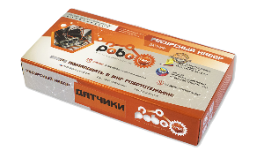
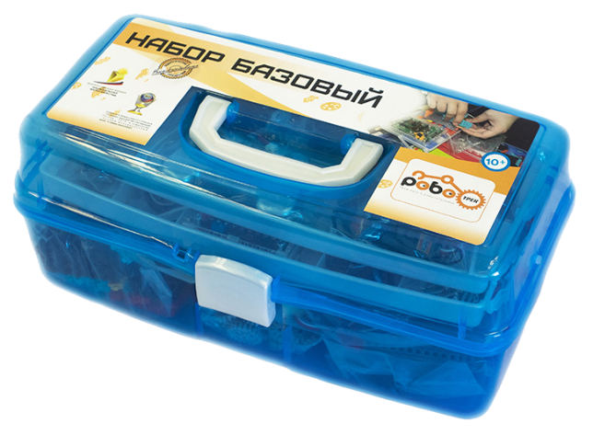
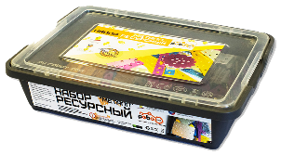
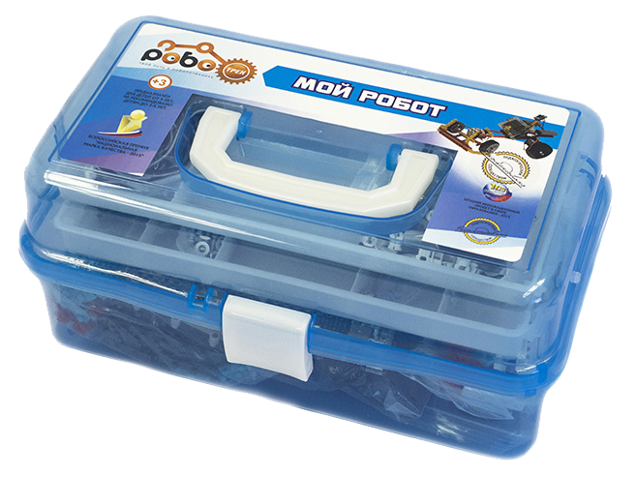
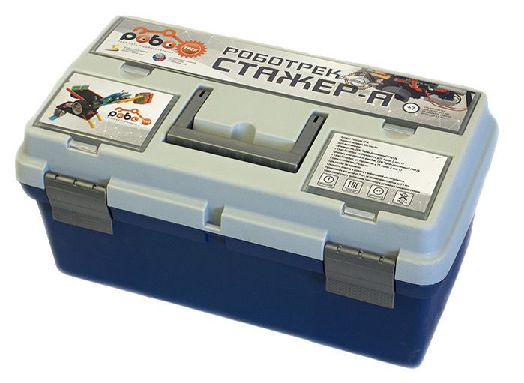
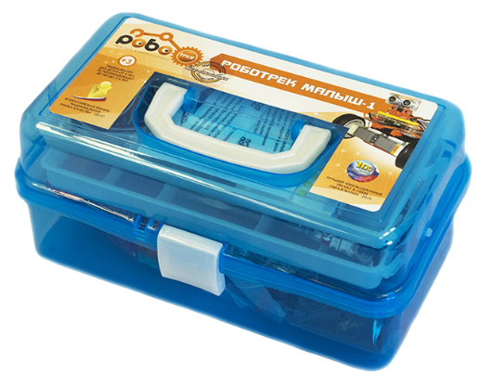
ROBOTRACK
Line of educational construction toy in robotics, neuroscience, systems of computer vision and additive technology "ROBOTRACK"
ENGINEER KIT
12+ y.o.
ROBOTRACK BASE KIT
YOUNG DISCOVERY KIT
12+ y.o.
INTERN A KIT
10-11 y.o.
7-9 y.o.
KIDDY KIT
4-6 y.o.

Slide 6
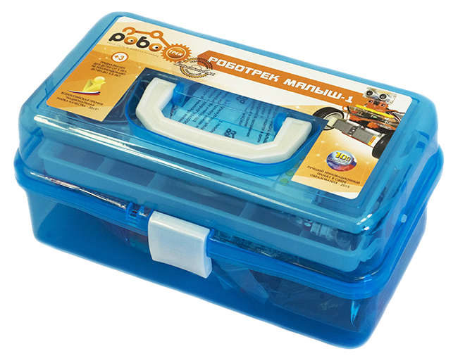
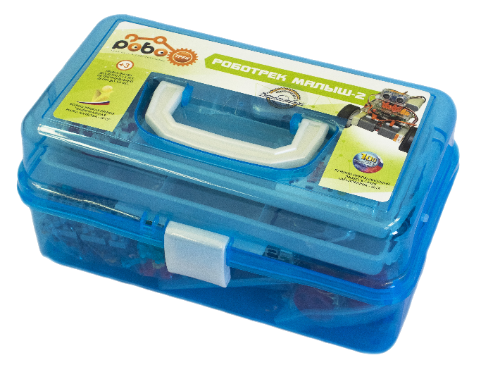
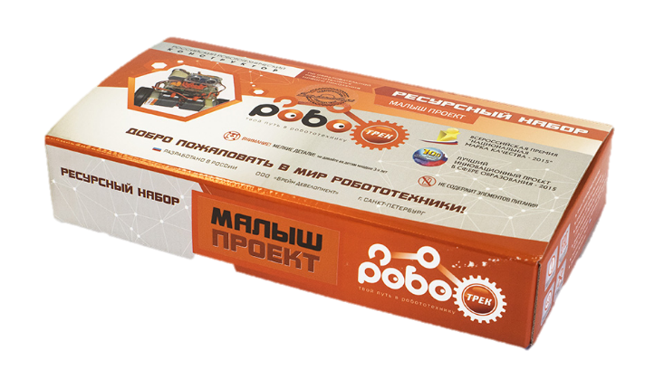
ROBOTRACK
Line of educational construction toy in robotics, neuroscience, systems of computer vision and additive technology "ROBOTRACK"
FOR PRESCHOOL EDUCATION
Resource Kit
«Kiddy Project»
Kiddy Kit II
Kiddy Kit I
The kit includes two motherboards: non-programmable and programmable.
Not less than 40 models for each Kiddy Kit.
A unique educational and methodical complex adapted for preschool children.
Helps to form the first skills of designing, develops the fine motor skills of children aged 5-6 years with the use of blocks of the construction toy set "Robotrack".

Slide 7
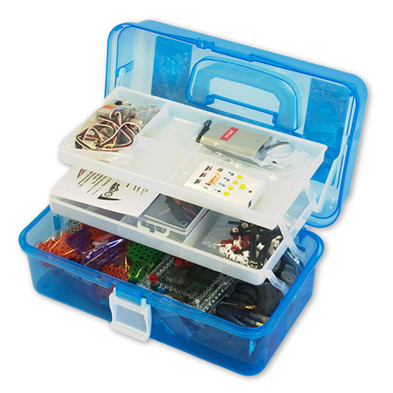
ROBOTRACK
Line of educational construction toy in robotics, neuroscience, systems of computer vision and additive technology "ROBOTRACK"
FOR PRESCHOOL EDUCATION
Educational Construction Toy “Kiddy Kit” is equipped with methodical recommendations, containing:
Theoretical material from the relevant subject areas of robotics (physics, mechanics, biology, etc.).
Material explains the basic principles of robotics.
Detailed instructions for assembling of each model.
KIDDY KIT

Slide 8
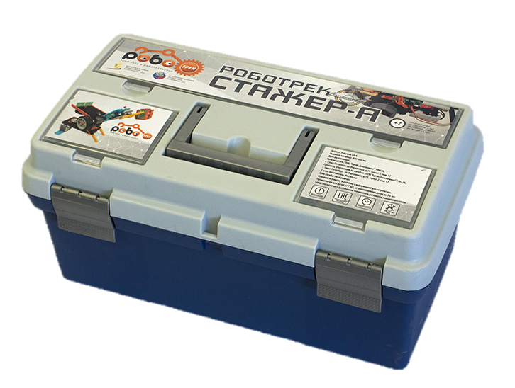
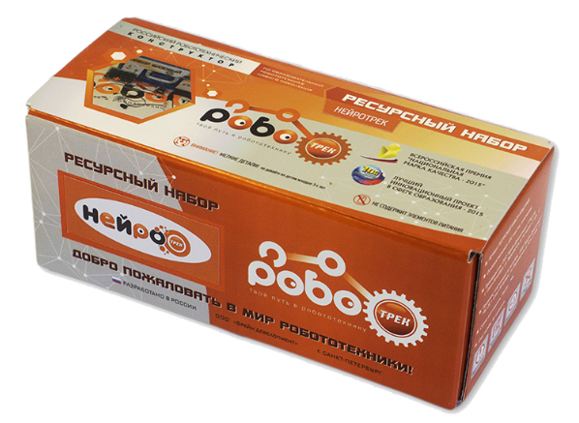
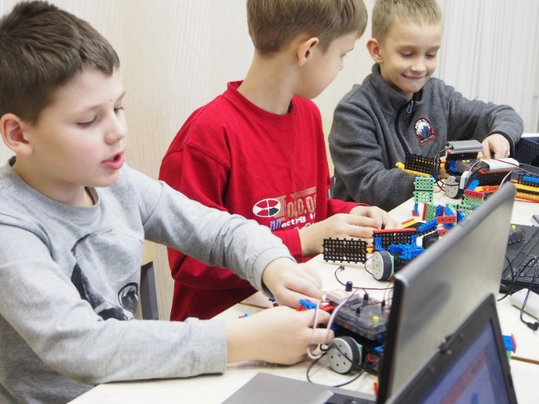
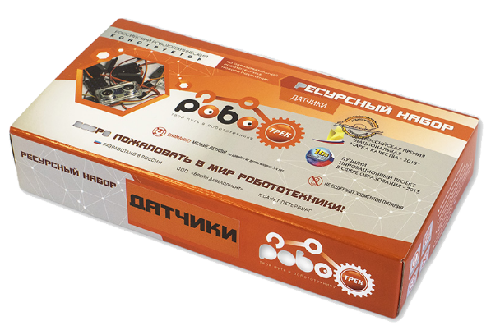
ROBOTRACK
Line of educational construction toy in robotics, neuroscience, systems of computer vision and additive technology "ROBOTRACK"
FOR BASIC GENERAL EDUCATION AND ADDITIONAL EDUCATION
(7-9 years old)
Resource Kit
«Sensors»
Resource Kit
«Neurotrack»
Intern A
Fascinating presentation of teaching material
Three motherboards
The educational-methodical complex is developed according to this age group
1 unprogrammable and 2 programmable
(baseline + advanced)
Develops spatial thinking
Minimal number of constructor details – 667.
The plastic details of the constructor are connected on six sides, which allows creating 3D models
Minimal number of sensors – 11.

Slide 9
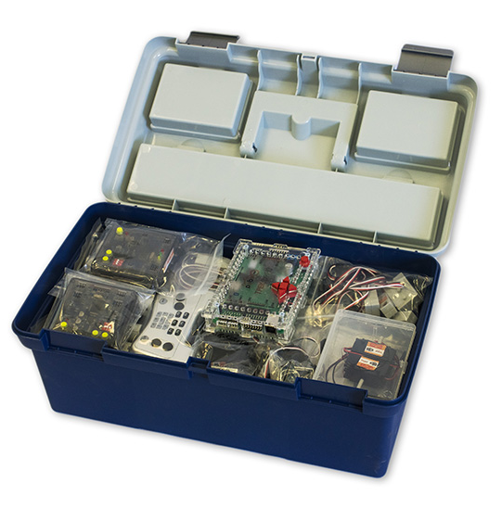
ROBOTRACK
Line of educational construction toy in robotics, neuroscience, systems of computer vision and additive technology "ROBOTRACK"
FOR BASIC GENERAL EDUCATION AND ADDITIONAL EDUCATION
(7-9 years old)
Educational Construction Toy “INTERN A” is equipped with methodical recommendations and:
Allows to form the basic skills of programming and understanding the work of real structures and mechanisms. Simple software and detailed instructions help to design and program a variety of robot models presented in the Intern A Kit.
Contains not less than 70 detailed instructions for assembling the models.
Elements of the designer are made of a durable material, it can be used in any robotic design.
INTERN A

Slide 10
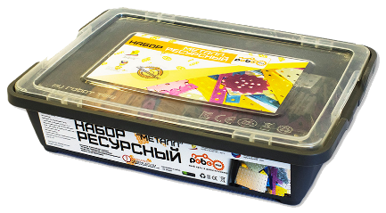
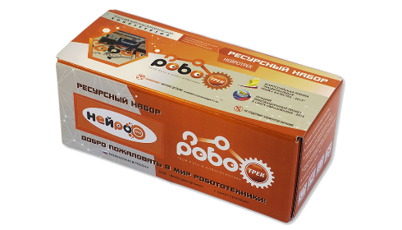
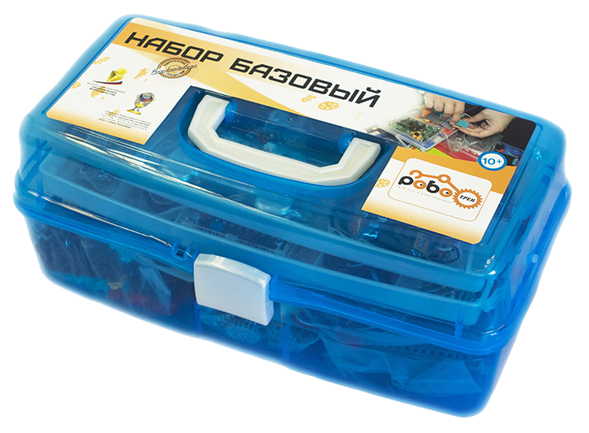
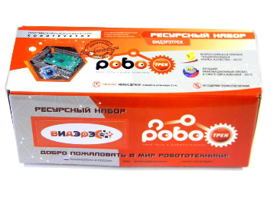
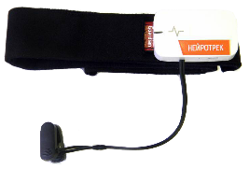
ROBOTRACK
Line of educational construction toy in robotics, neuroscience, systems of computer vision and additive technology "ROBOTRACK"
FOR BASIC GENERAL EDUCATION AND ADDITIONAL EDUCATION
(12+ years old)
Minimal number of constructor details – 828.
Resource Kit
«Metal»
Resource Kit
«Neurotrack»
Resource Kit
«Videretrack»
Minimal number of sensors – 11.
Resource Kit
«Sensors»
Robotrack
Base kit
A separate unique studying course of technical vision on the basis of the resource kit "Videretrack" and the Base kit + Sensors.
You can use electronic components of other manufacturers based on the Arduino platform.

Slide 11
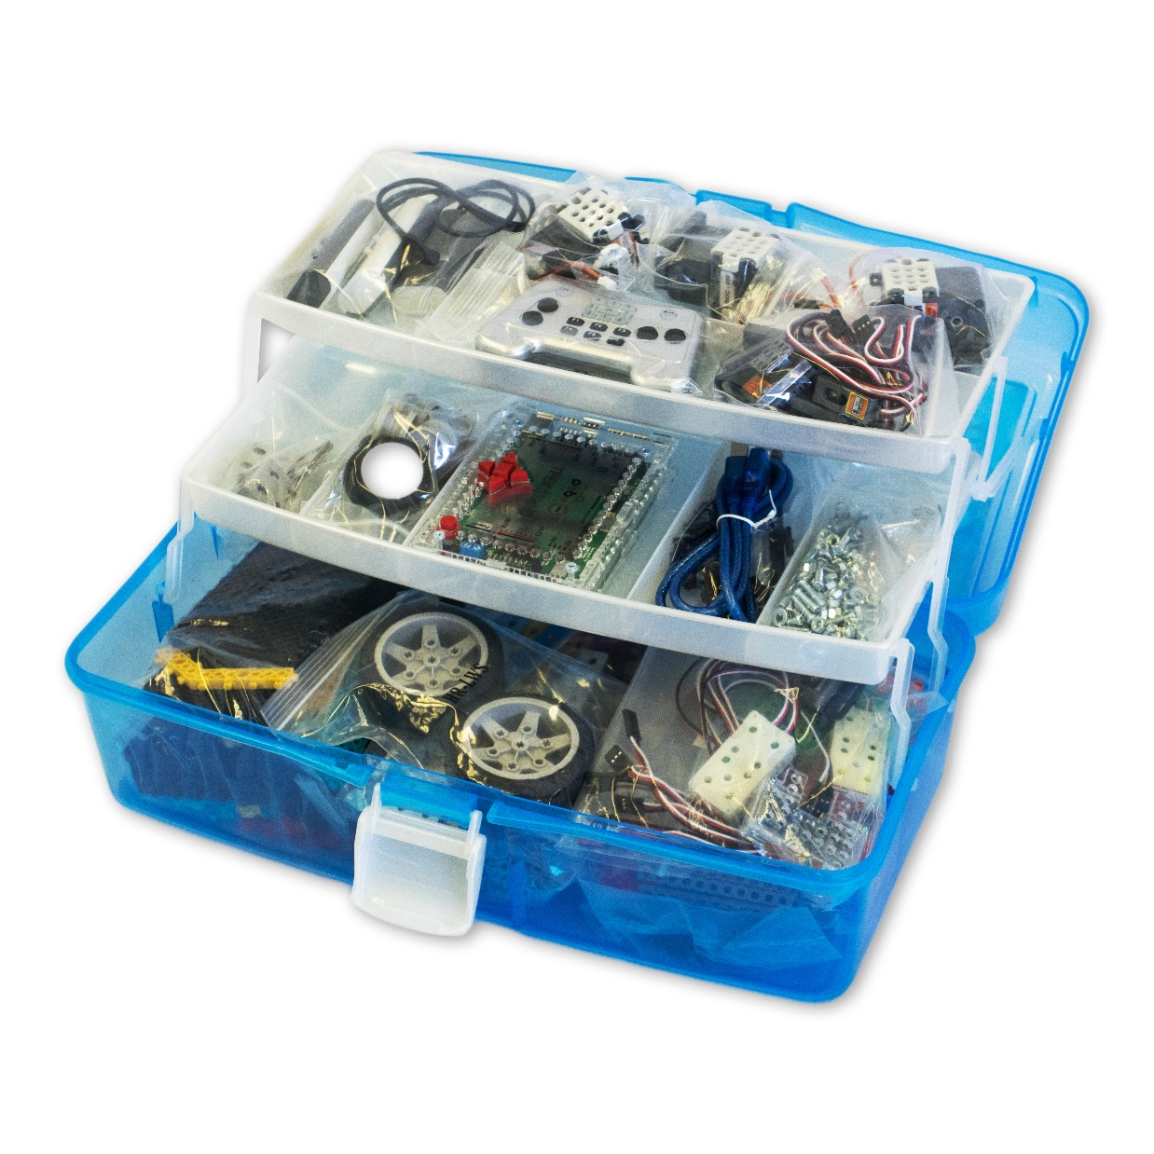
ROBOTRACK
Line of educational construction toy in robotics, neuroscience, systems of computer vision and additive technology "ROBOTRACK"
FOR BASIC GENERAL EDUCATION AND ADDITIONAL EDUCATION
(12+ years old)
Allows to study the basic principles of robotics and the theoretical foundations of mechanics, physics, computer science, studying the principles of the operation of sensors and execution unit, and the operation of the controller.
Not less than 60 detailed instructions for assembling the models.
Sensors included in Robotrack Base Kit: 3 IR sensors, CDs sensor, remote control sensor, 2 touch sensors, colour&light sensor, touch sensors, 2 external encoders, ultrasonic distance sensor.
Robotrack Base Kit
Elements of the construction toy set are made of a durable material, it can be used in any robotic design.

Slide 12
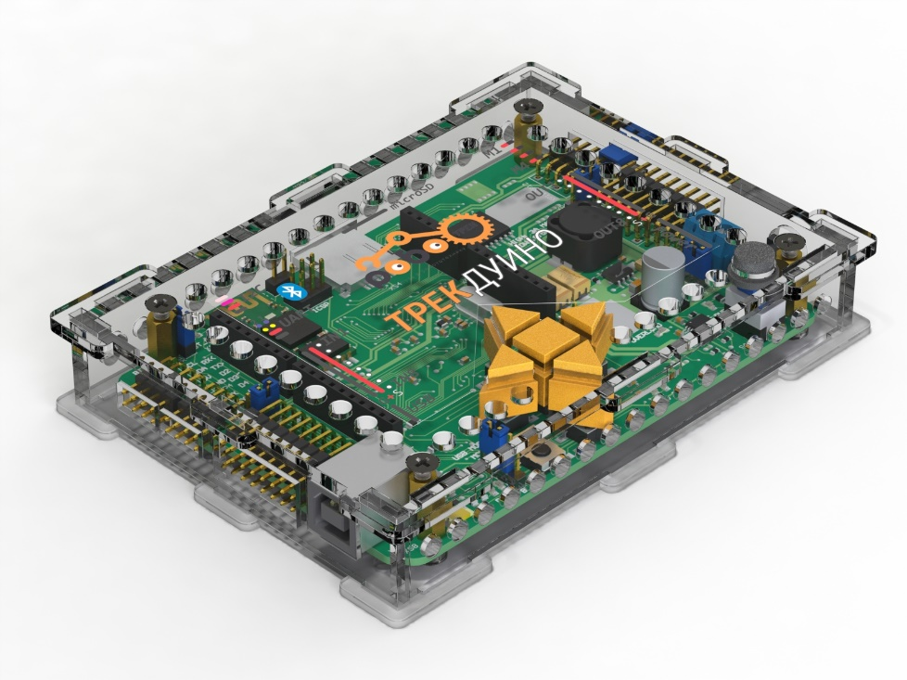
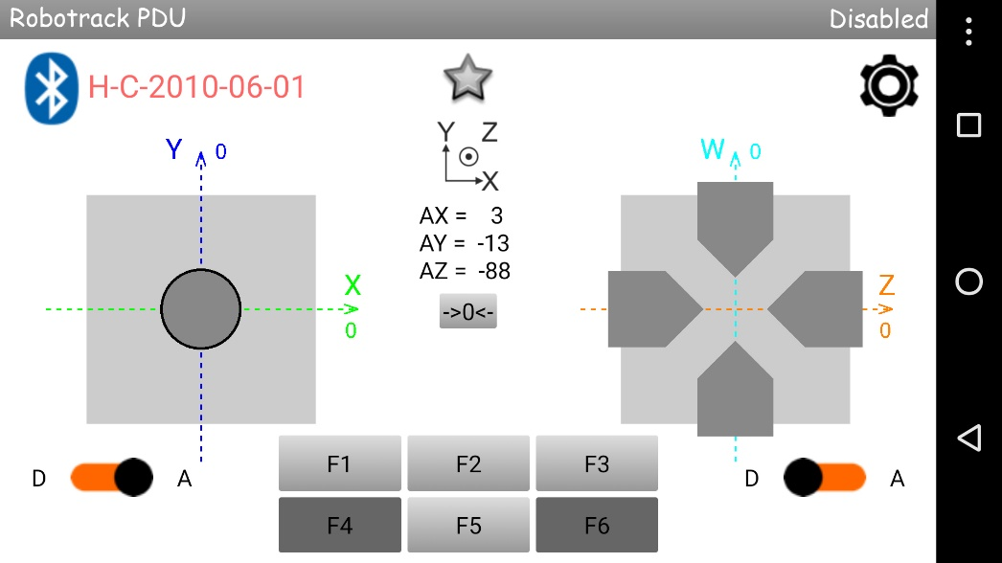
TRACKDUINO & SOFTWARE
TRACKDUINO – THE BASE CONTROLLER OF THE ROBOTRACK CONSTRUCTION TOY SET
Trackduino – a multi-functional controller, whose heart is the microcontroller Atmega2560. The controller has everything necessary to implement various robotic projects:
Drivers for 4 engines.
Well thought-out power system.
Power on all external ports.
Interfes Arduino Uno for connecting Arduino-compatible expansion cards.
Full compatibility with libraries and examples for Arduino.
The controller has several ports for connecting external devices. The ports IN and OUT are absolutely independent of all other ports, including the ports of Arduino Uno interface.
"Robotrack PDU" is an application for smartphones and tablets running on Android 4.0 or higher. It helps to control the robot based on Trackduino controller remotely via Bluetooth, in which the smartphone / tablet is used as a console.

Slide 13
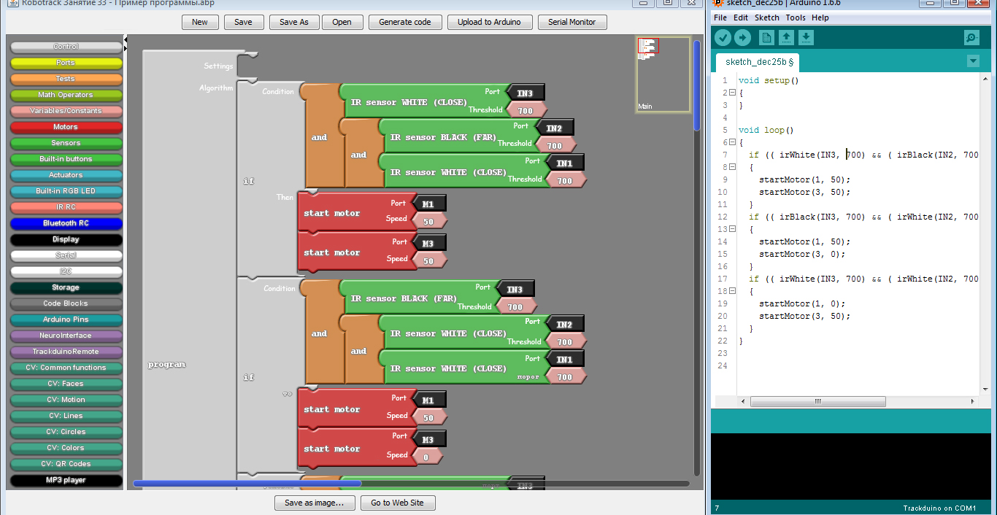
TRACKDUINO & SOFTWARE
Robotrack IDE is a development environment based on the Arduino IDE and supplemented with a visual programming environment for composing programs from blocks without having to write and edit code.
The Robotrack IDE is fully compatible with all Arduino boards and libraries, so if you work with the Robotrack and Arduino sets, you do not have to install multiple IDEs.

Slide 14
RESOURCE KIT
Allows you to extend the capabilities of the construction toy sets
Neurotrack
Videretrack
Metal
Fasteners
Wheels and caterpillars
Temperature sensor
Kiddy project
Bending sensor
Servomotor
DC motor
Trackduino
Color TFT display
Plastic
Sensors
Worm gear
Energytrack
Audiotrack

Slide 15
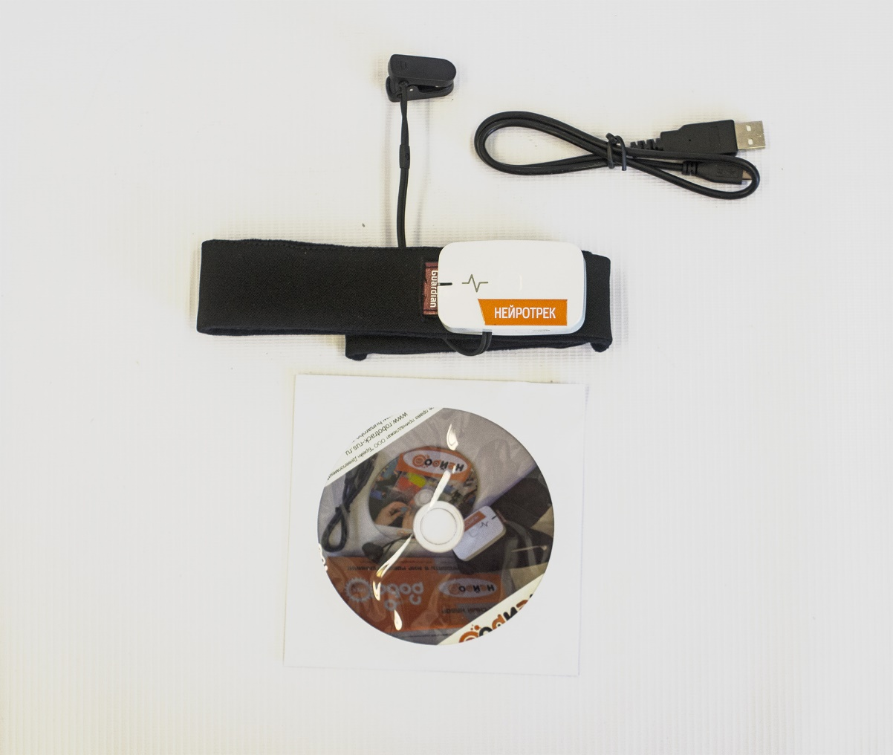
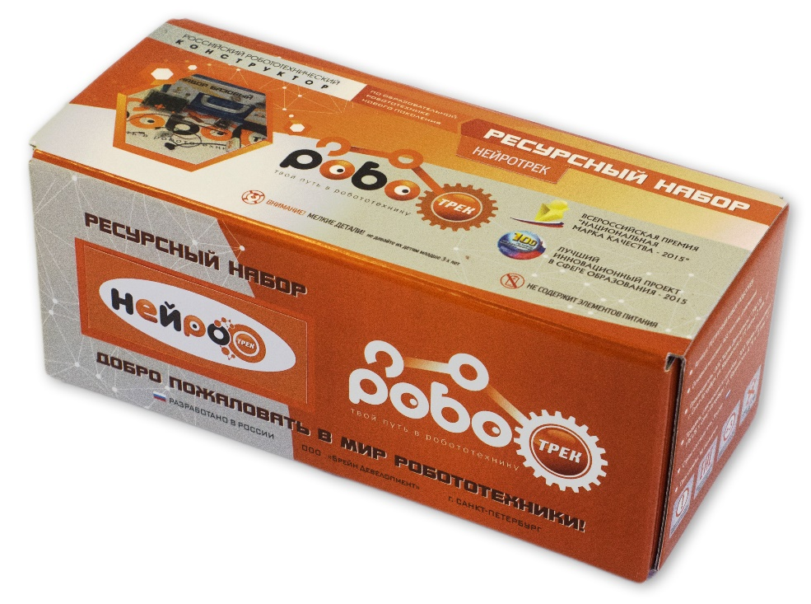
RESOURCE KIT
Allows you to extend the capabilities of the construction toy sets
RESOURCE KIT “NEUROTRACK”
The «NEUROTRACK» kit contains neurohandband that takes the electroencephalographic (EEG) signal from the brain by two sensors that touch the forehead and the left ear lobe. Then it transfers data to the computer via wireless technology (Bluetooth). There are 3 types of signals that will allow you to control the robotic model: concentration, meditation and eye blinking. Neurohandband works with the Trackduino controller.
The kit contains at least 3 components:
1 neurohandband;
micro-USB charge cable;
1 CD with software and instructions.

Slide 16
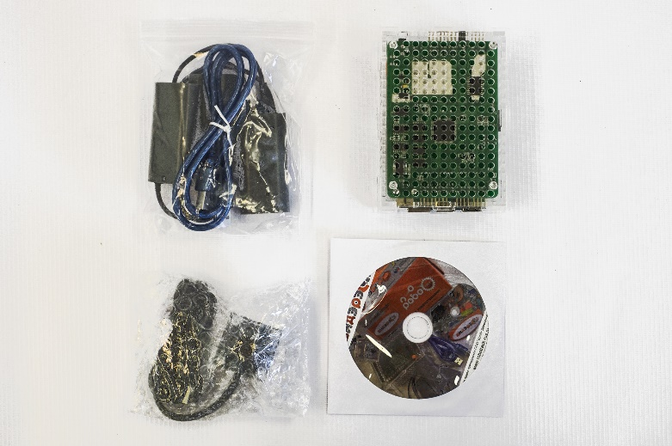
RESOURCE KIT
Allows you to extend the capabilities of the construction toy sets
RESOURCE KIT “VIDERETRACK”
«Videretrack» recourse kit extends the capabilities of the Trackduino controller by adding the microcomputer with a special operating system. Brain Development Ltd. developed a unique Training course on the study of the technical vision! This educational-methodical complex includes 30 lessons. By using this kit you will:
- form skills for designing of complex component constructions, using modern technologies of monocular computer vision,
- form skills to work with the regime of QR codes, the recognition of the object like "face" and the detection of graphical primitives,
- develop of skills of guide line tracking and motion search;
- develop of basic competencies for the analysis of colors using the Vitrek controller, HD cameras and robotic applications.
The kit contains at least 5 components:
Vitrek microcomputer in the case
HD-video camera (720 pel resolution) in the case
CD with software and instructions.
USB cable
case for 9 V batteries

Slide 17
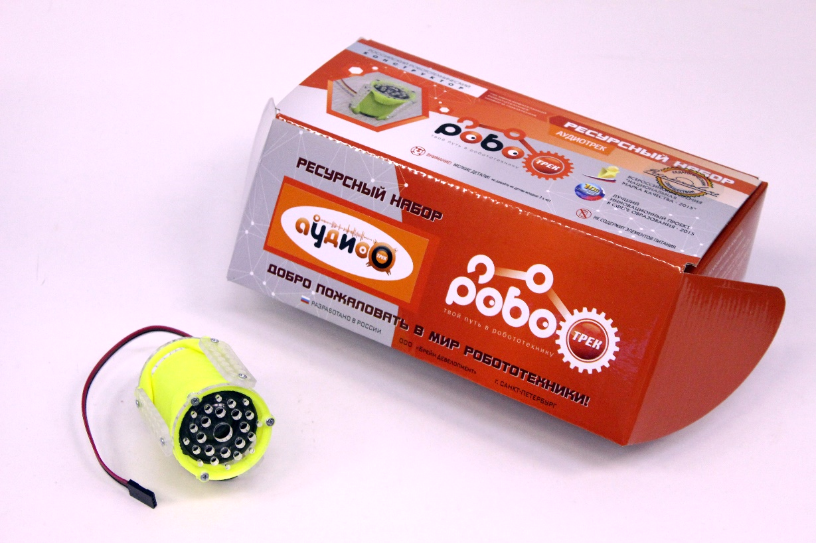
RESOURCE KIT
Allows you to extend the capabilities of the construction toy sets
RESOURCE KIT “AUDIOTRACK”
Audiomodule "Audiotrack" is designed to enhance the capabilities of the controller "Trackduino“. Allows you to play audio files in popular formats such as MP3, WAV and WMA. The module has a microSD card of 8 GB, so you can use it immediately after purchase. Built-in speaker with a power of 3W allows you to create fairly loud projects that will be heard in even in large auditoriums. The module is managed programmatically, it does not require additional power. With the help of libraries and graphic blocks included in the Robotrack IDE software, you can perform basic actions:
play a specific file;
play a specific file from the specified folder;
pause the track;
continue the track;
play the next / previous track;
increase / decrease the volume;
set the volume as a percentage from 0 to 100.

Slide 18
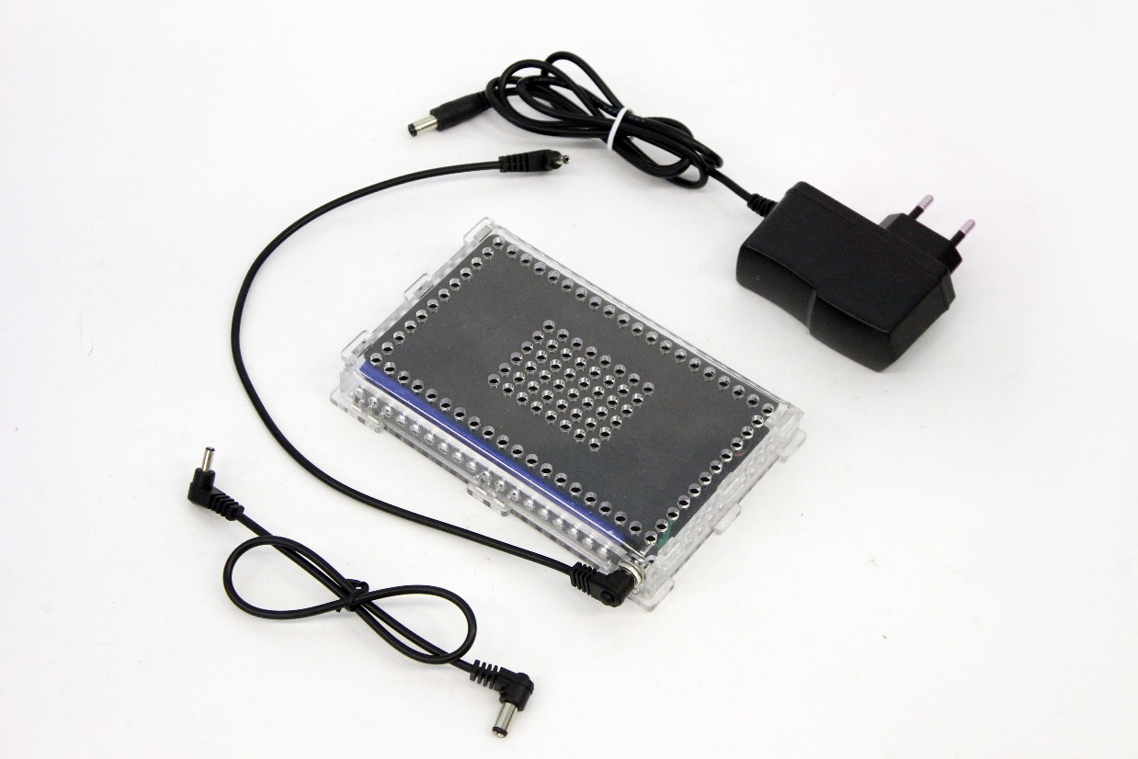
RESOURCE KIT
Allows you to extend the capabilities of the construction toy sets
RESOURCE KIT “ENERGYTRACK”
The battery pack "EnergyTrack" is intended for power supply of "Trackduino" boards and microcomputer Vitrek. "Energytrack" allows to ensure long-term operation of boards at maximum load, supports simultaneous use of 4 DC motors, together with servo motors, display, Audiotrack and other sensors/performers. It will be useful for the development of large-scale projects using educational kits "Robotrack". The electrolyte is a polymer material (Li-Po), which has a low self-discharge, no memory effect and a higher energy density per unit mass, compared to conventional Li-ion batteries. The body has openings for connection to the mechanical blocks of the educational kit "Robotrack", a single connector for connecting the charger and power consumers, inside the case there is a protective substrate.
The kit includes:
1 Battery pack
1 Charger
2 connecting wires

Slide 19
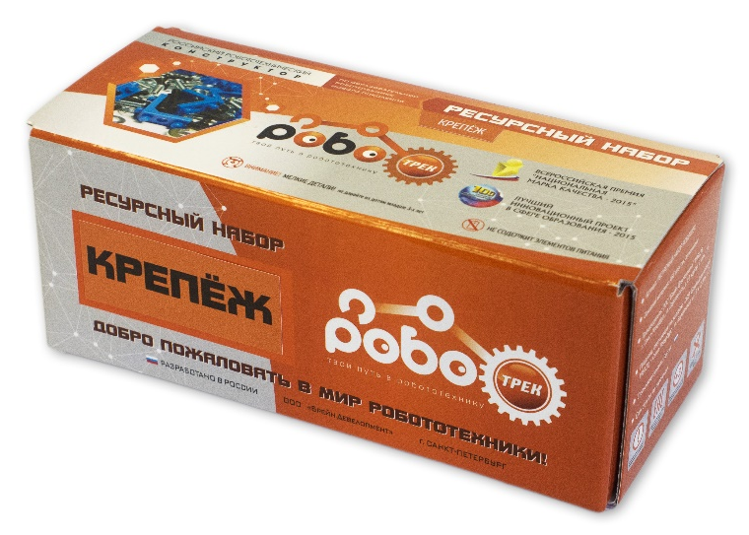
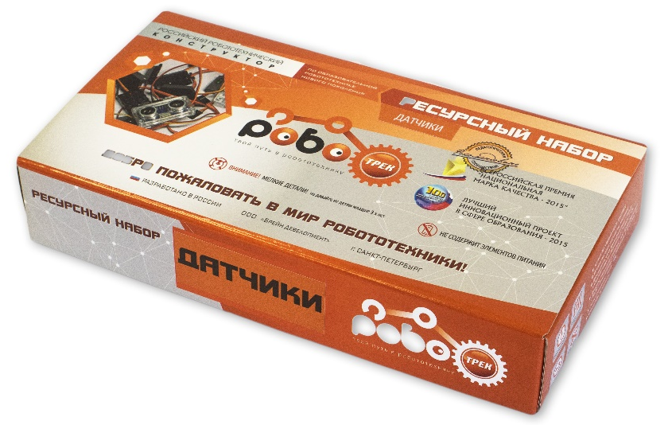
RESOURCE KIT
Allows you to extend the capabilities of the construction toy sets
RESOURCE KIT “FASTENERS”
“Fasteners” kit allows to increase the strength of the robotics structures by creating rigid connections.
The kit contains at least 377 components:
plastic corners;
bolts (4 sizes), screw-nuts and shims;
set of pins (5 sizes) and installation device;
screwdriver and wrench.
RESOURCE KIT “SENSORS”
The main task of the sensors is to present information from the external environment to the controller.
The kit contains at least 25 components: LED modules (3 colours); accelerometer / gyroscope;
2 external encoders; fire sensor; sound sensor; touch sensor; tilt sensor; vibration sensor;
magnetic field sensor; piezo-emitter; ultrasonic distance sensor; colour sensor + light sensor
remote sensor; infrared sensor; loudspeaker.

Slide 20
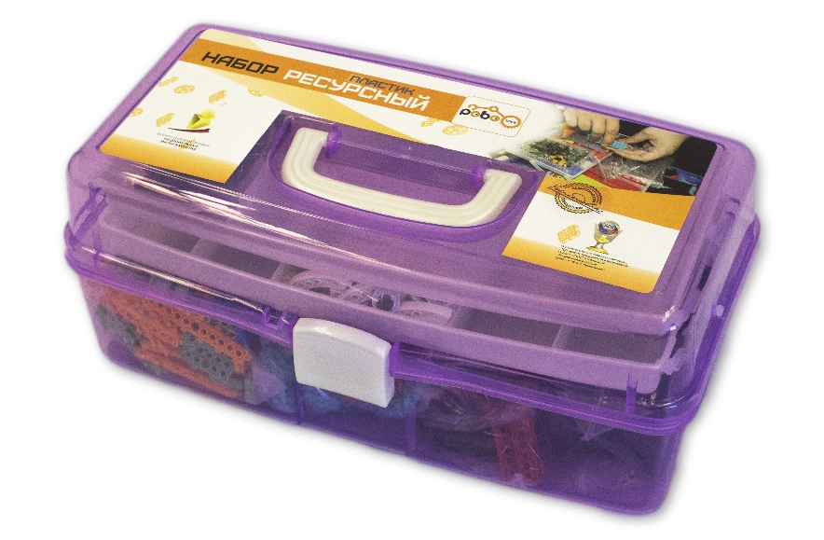
RESOURCE KIT
Allows you to extend the capabilities of the construction toy sets
RESOURCE KIT “PLASTIC”
The kit extends the designing capabilities, allows to create various three-dimensional models.
The kit contains at least 511 components:
plastic beams of different shapes (5 types), blocks (at least 11 types) for object construction;
plastic corners, arcs, eyes;
engine fastening frames (3 types);
adapters (2 types);
6 rubber plates.
RESOURCE KIT “METAL”
The metal elements of the kit allows to create strong and durable constructions and gears.
The kit contains at least 342 components:
60 metal plates for object construction;
coupling beams (2 kinds);
bolts (4 sizes), screw-nuts and shims;
screwdriver and wrench;
aluminium arcs;
aluminium gear wheels.

Slide 21
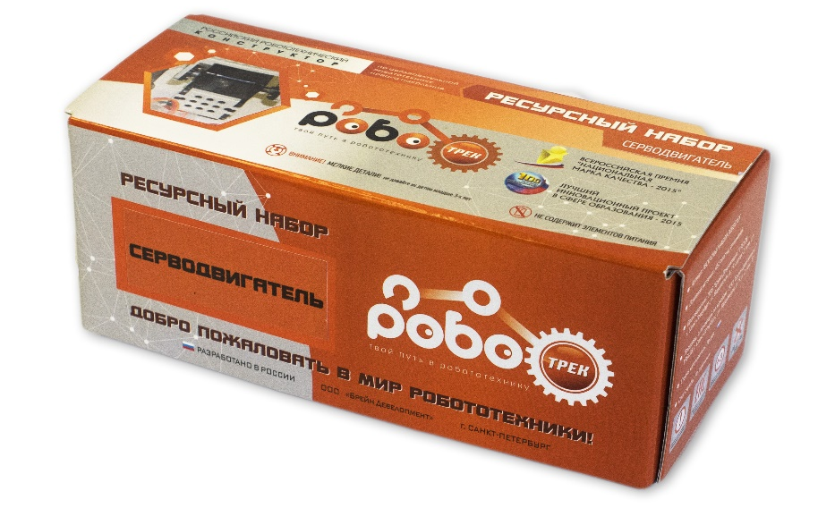
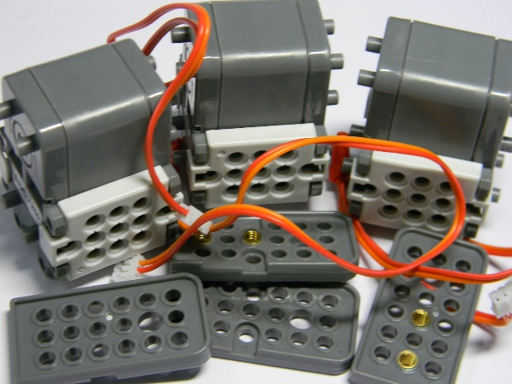
RESOURCE KIT
Allows you to extend the capabilities of the construction toy sets
RESOURCE KIT “WHEELS AND CATTERPILLARS”
The kit allows to expand the mobility, increase the cross-country capability of the robotic systems.
The kit contains at least 120 components:
wheels (8 types and sizes);
set of links for caterpillar.
RESOURCE KITS “SERVOMOTOR” AND “DC MOTOR”
Resource kit “DC MOTOR” is needed to increase the number of used engines in robotic models.
The kit contains 4 components:
DC motor;
set of frames.
Resource kit “SERVOMOTOR” helps to simulate the various movements of robots.
The kit contains 5 components:
servo motor;
set of servo horns (big and small);
set of frames.

Slide 22
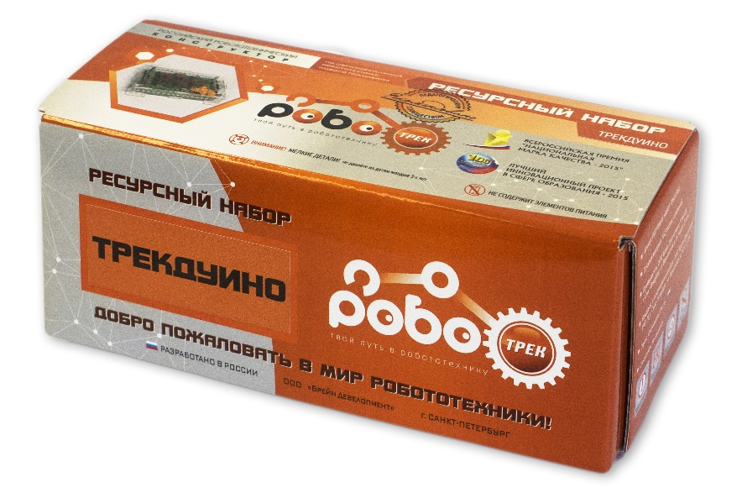
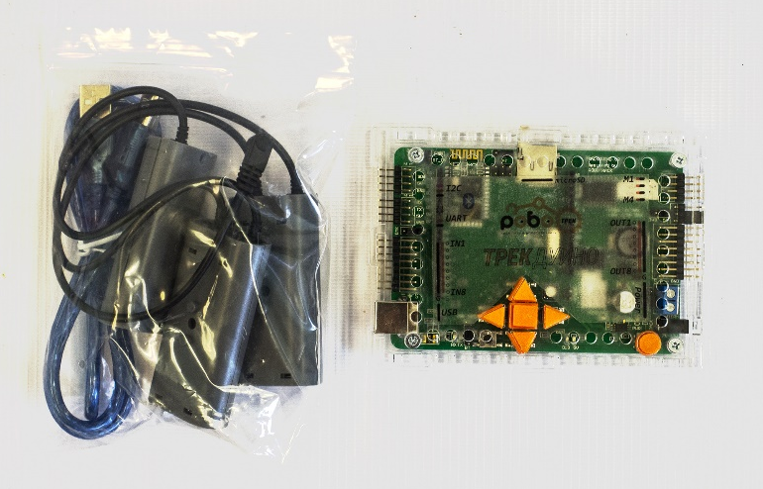
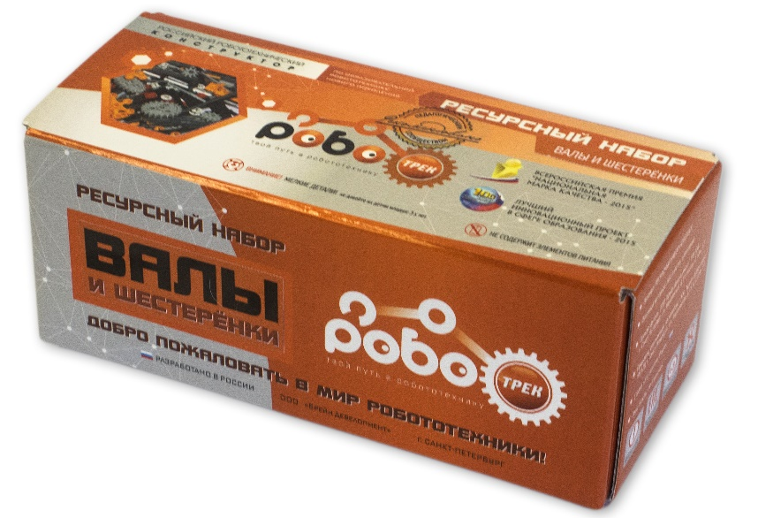
RESOURCE KIT
Allows you to extend the capabilities of the construction toy sets
RESOURCE KIT “TRACKDUINO”
“Trackduino” kit provides a huge opportunity to create any robots, you can connect sensors, motors, displays.
The kit contains 3 components:
Controller Trackduino;
USB cable;
case for 9 V batteries.
RESOURCE KIT “SHAFTS AND GEARS”
Resource kit “Shafts and gears” allows to create swivel joints, complex fasteners, as well as gear-based mechanisms.
The kit contains at least 328 components:
plastic (4 types) and aluminium (5 types) shafts;
plastic, rubber and metal couplings;
plastic sleeves (2 types); gears (4 types), levers.

Slide 23
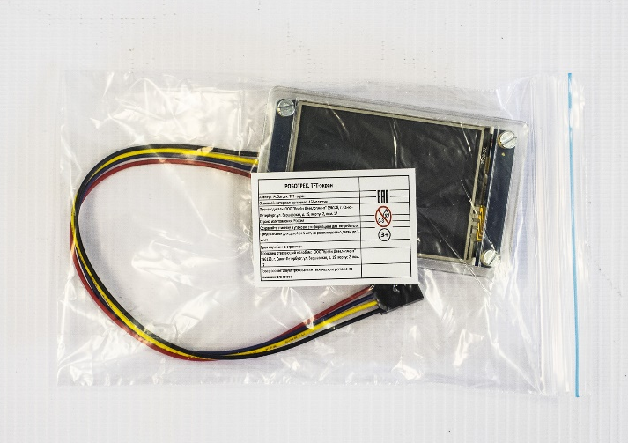
RESOURCE KIT
Allows you to extend the capabilities of the construction toy sets
RESOURCE KIT “COLOR TOUCHSCREEN TFT DISPLAY”
This kit comes in handy for displaying graphic information: text, images and simple drawings. The display has the 320x240 pel resolution, is controlled by UART and has a resistive touchscreen.
With the help of libraries and graphic blocks included in the Robotrack software, you can perform basic actions: to draw some geometric figures, to display the text, to turn on the drawing mode on the touch-screen.
The kit contains 1 color touchscreen TFT display.
RESOURCE KIT “TEMPERATURE SENSOR”
The temperature sensor is useful for measuring the temperature of air, liquids and other objects in a wide temperature range (from -55 to +125 Celsius degrees) with an error of +/- 0,5 degree in the range from -10 to +125 degrees.
The kit contains 1 temperature sensor.

Slide 24
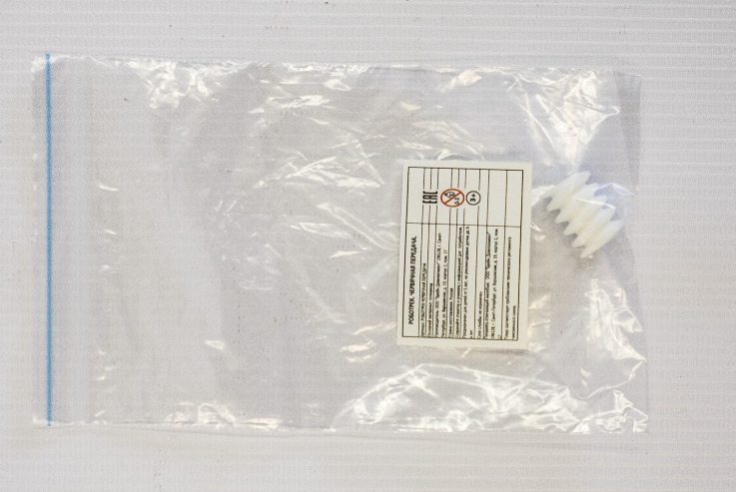
RESOURCE KIT
Allows you to extend the capabilities of the construction toy sets
RESOURCE KIT “WORM GEAR”
Helical gear is necessary for complex mechanical transmission creation and for increase of the lifting mechanisms power and the motion transferring at the angle of 90 degrees.
The kit contains 1 worm gear.
RESOURCE KIT “BENDING SENSOR”
Bend sensor can be used:
for measuring of various angles and displacements;
for obtaining information about the device physical condition and/or about device movement on the basis of various bends analysing.
The kit contains 1 bend sensor.

Slide 25
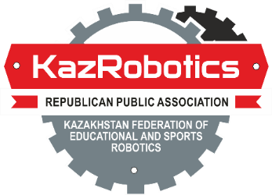
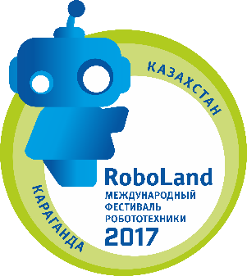
COMPETITIONS
Line of educational construction toy Robotrack can be used at various children's and youth competitions in robotics and neurotechnology both in Russia and Kazakhstan, and at the International competitions such as IYRC.
"Brain Development“ Ltd. is the organizer of the all-Russian robotics and neurotechnologies Children's Competition "DETAL'KA". The annual robotics competition for preschool children and junior schoolchildren "DETAL'KA" is held within the framework of international cooperation in the field of educational robotics development with the International Youth Robot Association (IYRA).

Slide 26
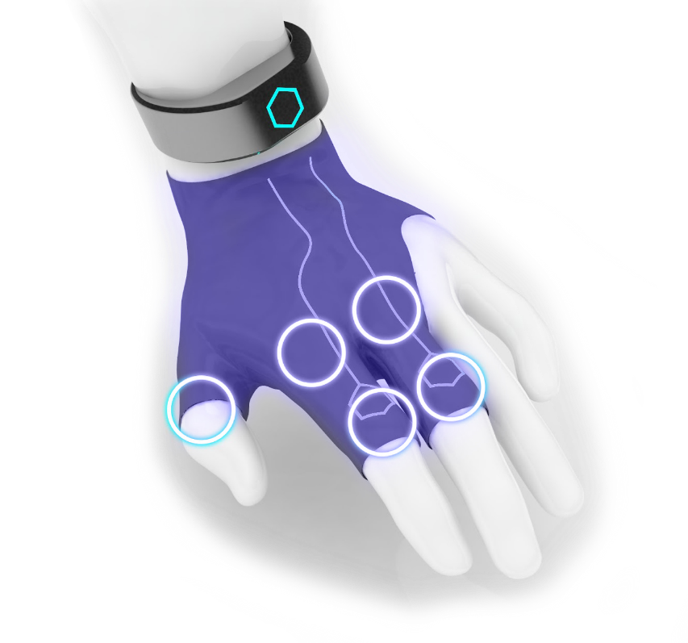
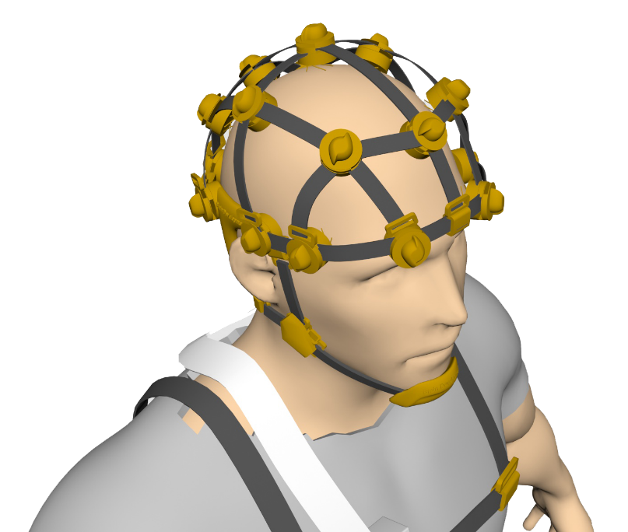
PERSPECTIVES
Gesture
recognition
Sound
module
Gloves for control
complex “Robotrack”
Young Neurophysiologist-Engineer

Slide 27
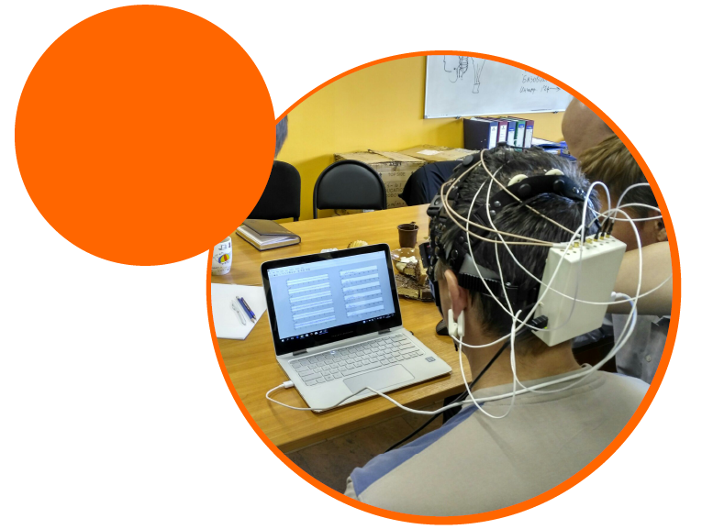
PERSPECTIVES
Starting from 2019, after the ROBOTRACK "Base kit" course, will be available a package for training sessions called "Young Neurophysiologist-Engineer" designed for studying human neurophysiology, collecting and processing biosignals (EEG, ECG, CGR, EMG) and controlling robotic models.
YOUNG NEUROPHYSIOLOGIST-ENGINEER

Slide 28
CONTACTS
CEO “Brain Development” Ltd.
Babenkova Nadegda
CFO “Brain Development” Ltd.
Skazochkin Leonid
+7 921 330 25 68
mrtrus2014@yandex.ru
slp10@yandex.ru
Web-site: robotrack-rus.ru
facebook.com/robotrackrus
instagram.com/robotrackrus

