Slide 1
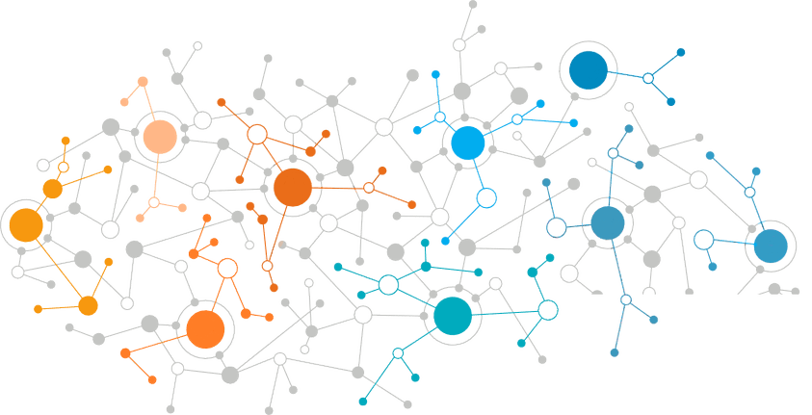
Young neuro-engineer

Slide 2
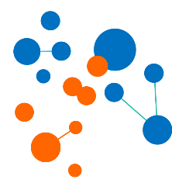
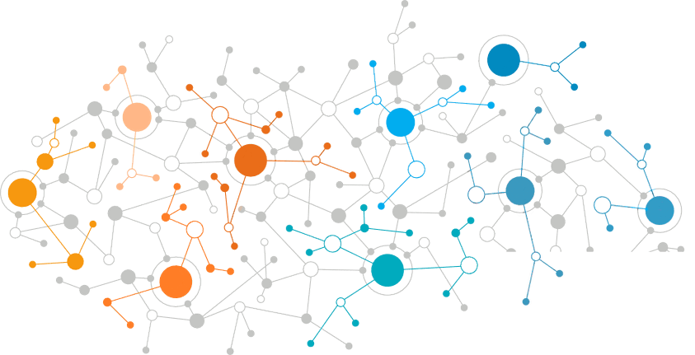
ABOUT US
Brain Development Ltd. was established in 2012 in Saint Petersburg, Russia.
It is the developer and the manufacturer of the first home robotic complex ROBOTRACK for the education system from kindergarten to university.
It is the creator of the network of ROBOTRACK International Clubs of more than 120 clubs in Russia and Kazakhstan, in 47 regions and cities of Russia and Kazakhstan.
OUR PARTNERS

Slide 3
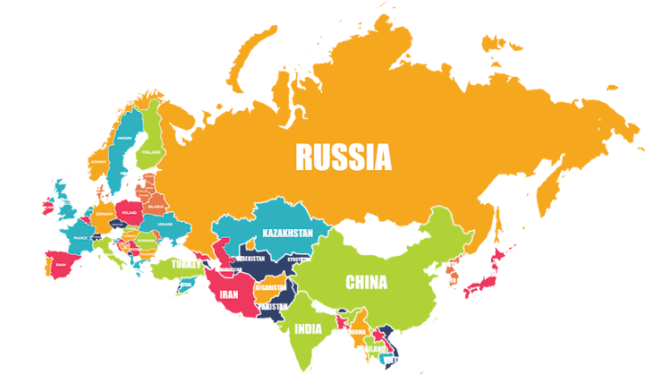
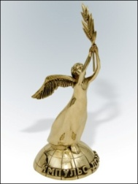
Our achievements
More than 120 Clubs are opened in regions of Russia and Kazakhstan.
More than 40,000 children are enrolled in public and private educational institutions of the country based on the developed teaching materials.
We are the official representative of the International Youth Robot Association (IYRA) in Russia.
Brain Development company took 1st due to ROBOTRACK project in the category of Personal Contribution to the Development of Social Entrepreneurship in Russia at the VI Impulse of Good Award.
In March 2016 and 2017, the company won the 1st Interagency Competition of Manufacturers and Suppliers of Educational Equipment and Tutorials “Tutor’s Choice”.
As a part of the Congress of Children Products Industry, the Award Ceremony of the Best Home Producers was held on September 29, 2017. According to the contest results of Ministry of Industry and Trade of Russia the Brain Development company has entered TOP-10 Best Russian Producers.

Slide 4
Realization of Neurolaboratory creation
Due to the implementation of National Technological Initiative and definition of new markets that should be established by 2035 to make Russia more competitive on the world technology market and to form a digital economy with respect to the requirements of NTI road map and top occupations of the future, Brain Development Ltd. has developed and implemented Young Neuro-Engineer project.
The teaching materials will help guide children towards occupations of future connected with neurological and psychological fields, robotics and related fields as well as form primary skills of future scientists – neuropsychologists and neurotechnologists.

Slide 5
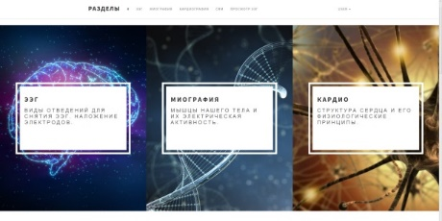
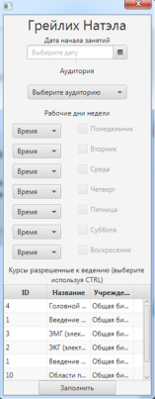
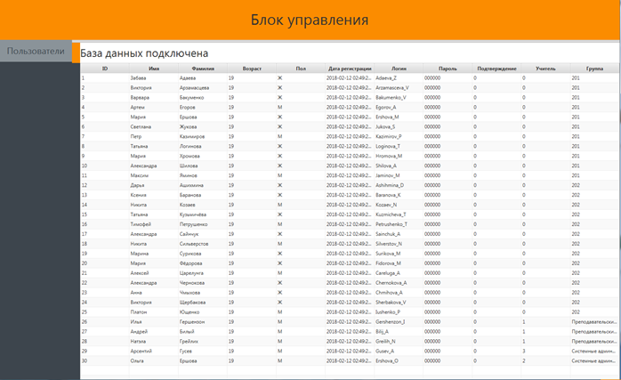
Our goals :
development of the occupation competences of future,
overcoming of technical barriers of NTI road maps.
EQUIPMENT
electroencephalograph
Electronic Equipment
Instruction and
methodology Training.
basic network platform
CRM
(Data Analyzing Center)

Slide 6
Young neurophysiologist-engineer
Specifically designed equipment and training course enables children the following:
To conduct researches on human neuro- and psychophysiology;
To use neurotechnology to control robot models based on their own indications of brain bioelectric activity;
To study the structure of cardiovascular system and heart, determine own heart rate variability, etc.; study the structure and the anatomy of human skin, its electrical conductivity;
To study the anatomy of human muscles, functional state of muscle tissues and nerves through recording the myoelectrical activity; to plan own learning path.

Slide 7
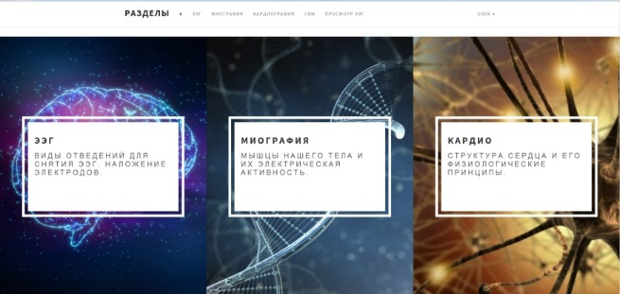
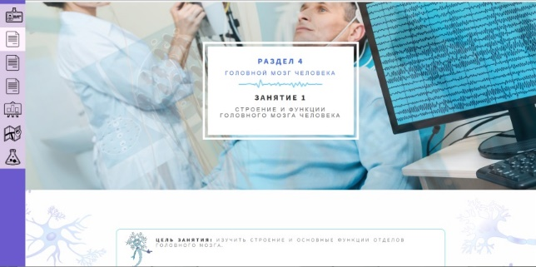
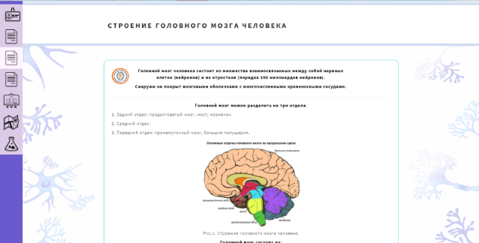
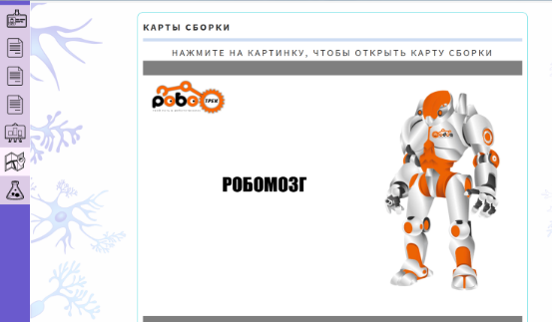
Instruction and methodology Training
128 hours, lessons two days a week throughout the year or once a week throughout two years.
12 course sections cover the following:
1. Introduction to Neurotechnology (3 lessons).
2. A study of heart activity (10 lessons).
3. A study of muscle activity, nerve conductivity properties, skin electrophysiological activity (6-8 lessons).
4. Human brain, function and structure, study method, application of electrodes, biorhythms, event-related potentials, BFB, Р300 (27 lessons).
5. Brain-Computer neurocomputer interface (6 classes).
6. Field of neurotechology application, exercise stress tests, polygraph mode, etc. (6 lessons).
7. Device control (virtual reality, bionics, neurological programming) (5 lessons).
8. Vocational guidance.

Slide 8
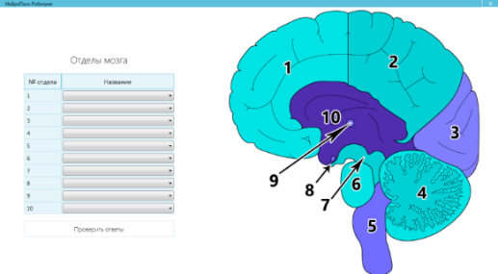
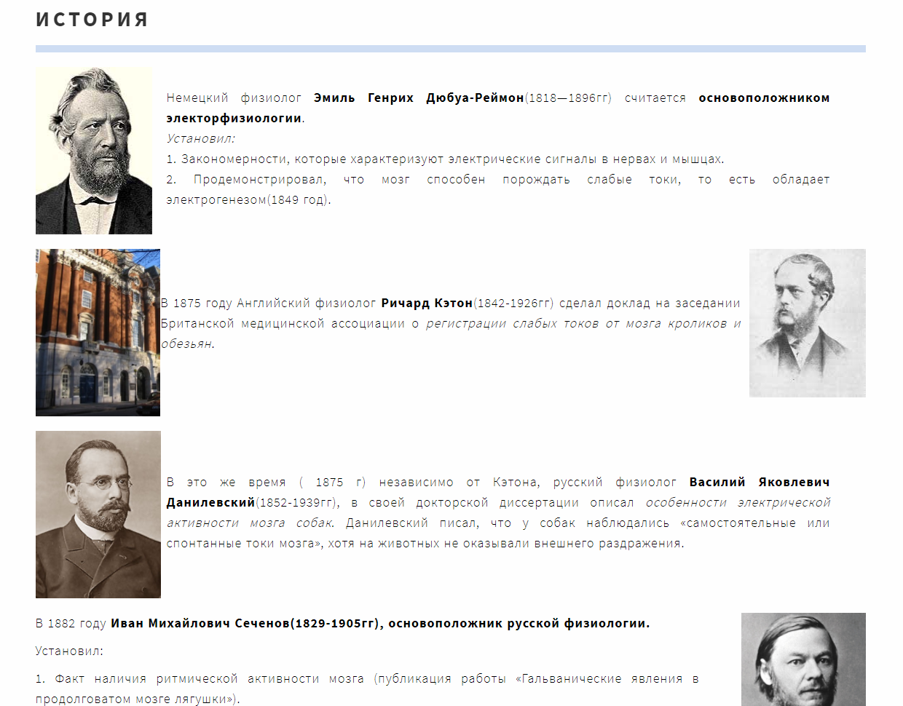
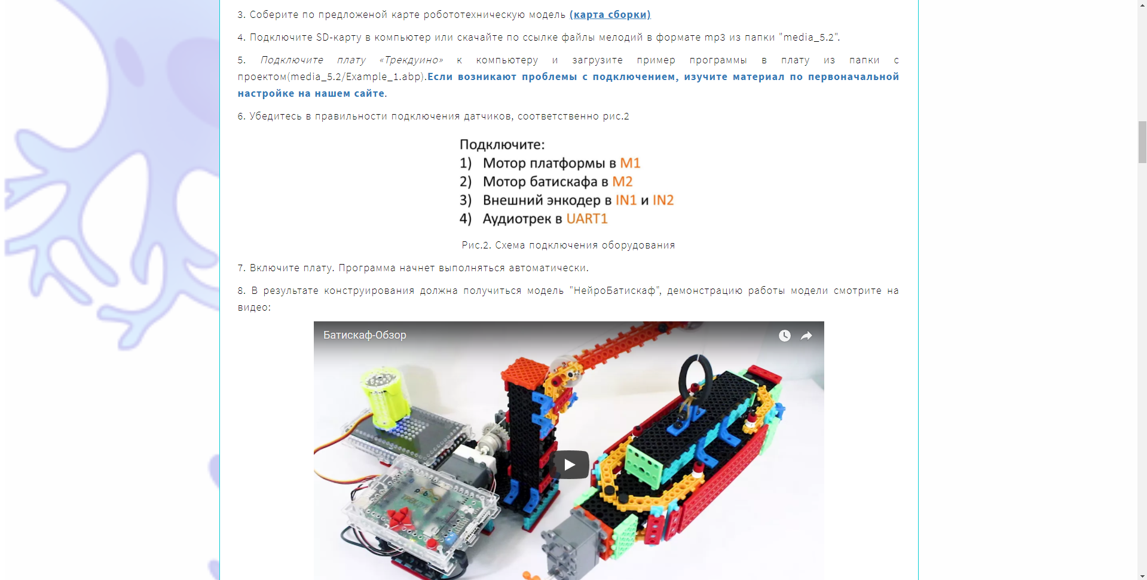
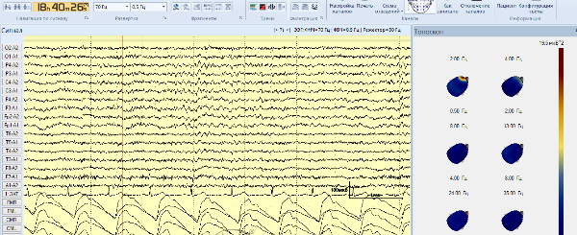
Instruction and methodology Training
This course enables children to plan own learning path and includes the following:
theory;
4 types of laboratory researches;
virtual museum;
glossary;
robotic model assembly charts;
notebook (learner's workbook which allows taking notes online and viewing own notes from a smartphone outside the classroom);
robotic model assembly charts.

Slide 9
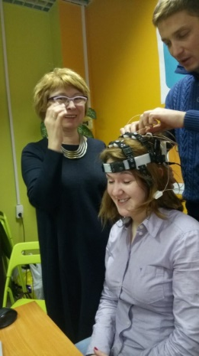
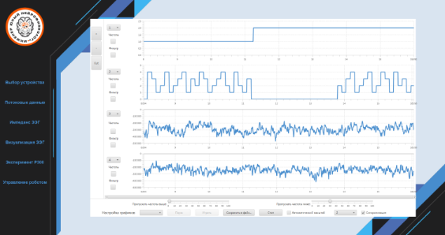
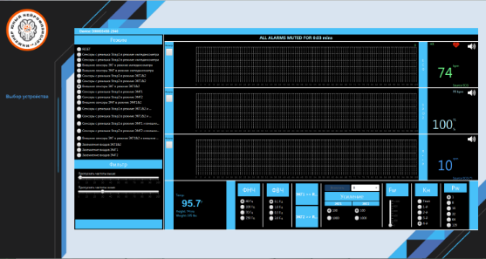
Equipment
electroencephalograph
Electronic Equipment
8 EEG channels;
“dry” electrodes;
high quality signal;
wireless data transmission;
syncing with ECG, EMG, GSR, PPG (photoplethysmogram);
performing ECG, EMG, GSR.

Slide 10
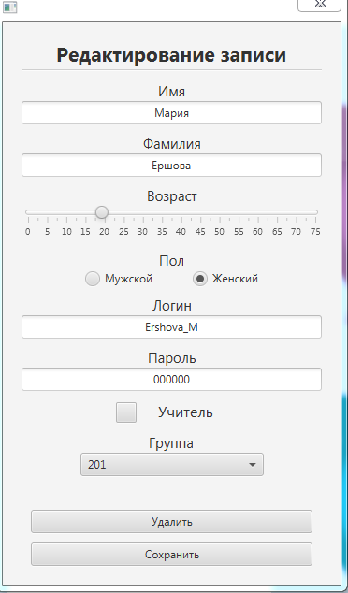
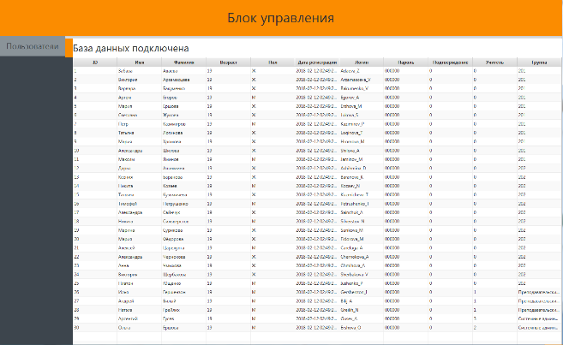
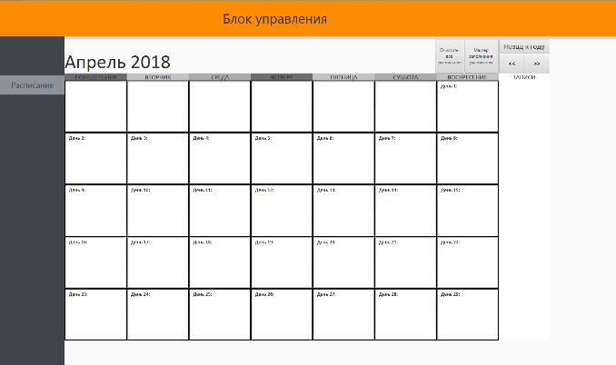
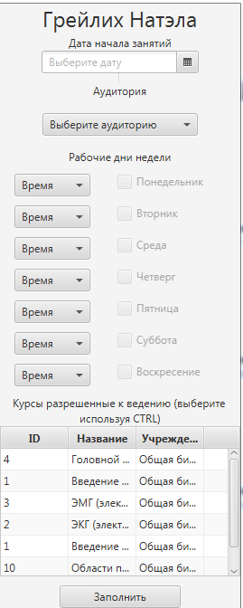
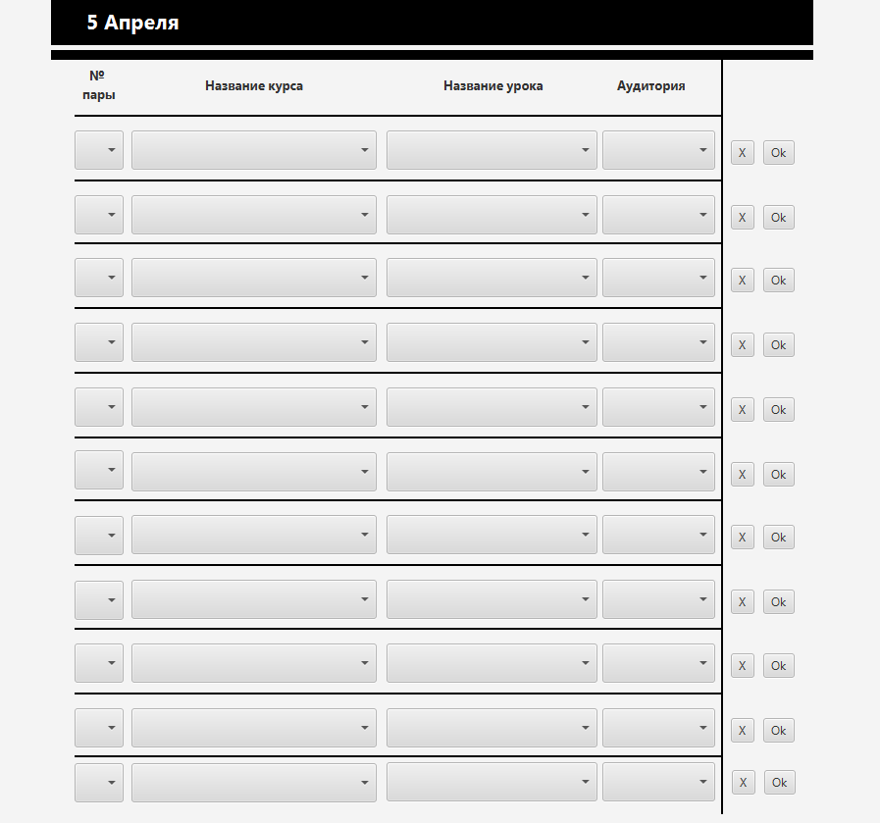
Data Analyzing Center
Storage and update of theoretical and practical parts of IMT and data.
Development of pattern database.
Storage of work results.
Accumulation of large amounts of data and class work results to improve the accuracy of the system performance, development of classifiers, etc.

Slide 11
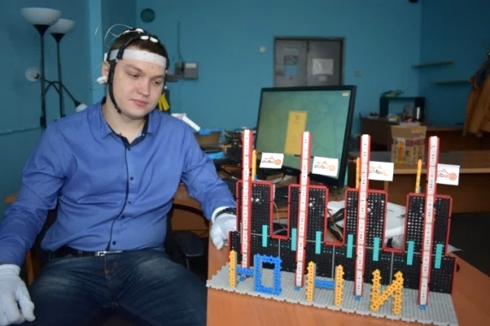
Р300
P300 signal (event-related potencial) – is an electrical response of the brain to stimuli. In our case a stimulus is a group of pictures, as shown in Fig.1. At the start, the system is trained to identify the view direction of an operator on a certain arrow (creating a personal classifier). A training success result appears after training the system. The quality of the developed classifier is the percentage of correspondence of the actual visual direction and integrated mathematical model of the machine. The higher the percentage of the match (Fig.2), the more accurate is the detection of a produced signal, upon which the effective management of a robotic model depends – in our case, hoisting the flags up.
Figure 1
Figure 2

Slide 12
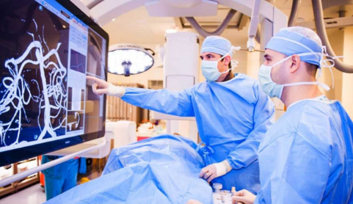
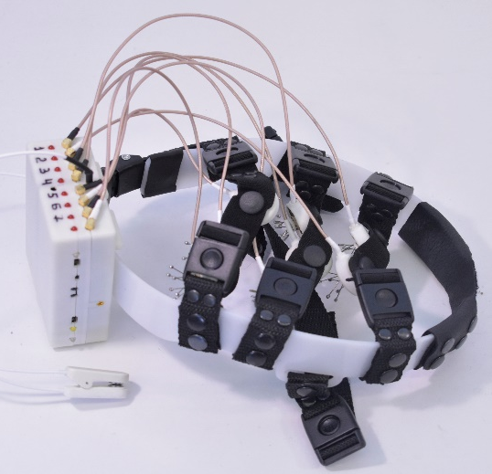
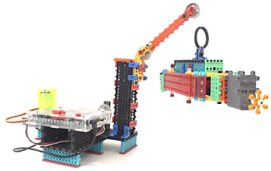
Instruction and methodology Training
Going through the course, children will be able to learn to control the robotic models using human bioelectric activity, to study human neurophysiology, to find out how they can enhance mental activity, and to decide what they want to be in future: neurodevelopers and researchers or neuropilots as well as become familiar with the related high technology.

Slide 13
Out contacts
President of ROBOTRACK Group
Nadezhda Babenkova
CEO Brain Development Ltd.
Leonid Skazochkin
8 921 330 25 68
mrtrus2014@yandex.ru
8 965 007 40 77
slp10@yandex.ru
Official web site: robotrack-rus.ru
instagram.com/robotrackrus
vk.com/robotrackrus

